Slide 1


Identifying Heart Abnormalities
By: Zach Young

Slide 2
Heart Disease in the United States
Heart disease is the leading cause of death for men, women, and people of most racial and ethnic groups in the United States.
One person dies every 37 seconds in the United States from cardiovascular disease.
About 647,000 Americans die from heart disease each year—that’s 1 in every 4 deaths.
Heart disease costs the United States about $219 billion each year from 2014 to 2015. This includes the cost of health care services, medicines, and lost productivity.
However, if irregularities are identified soon enough, preventative measures can be taken saving both lives and money.

Slide 3
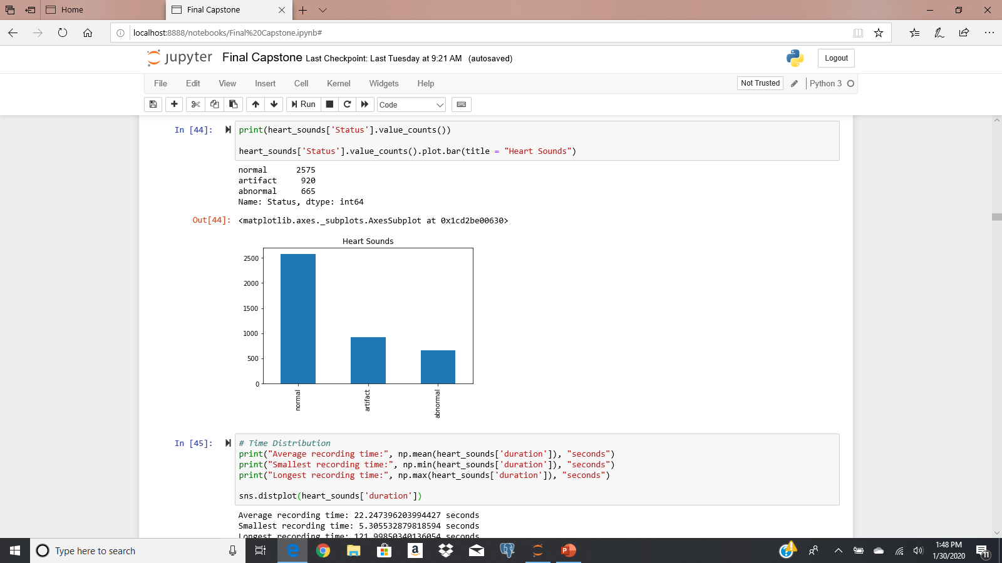
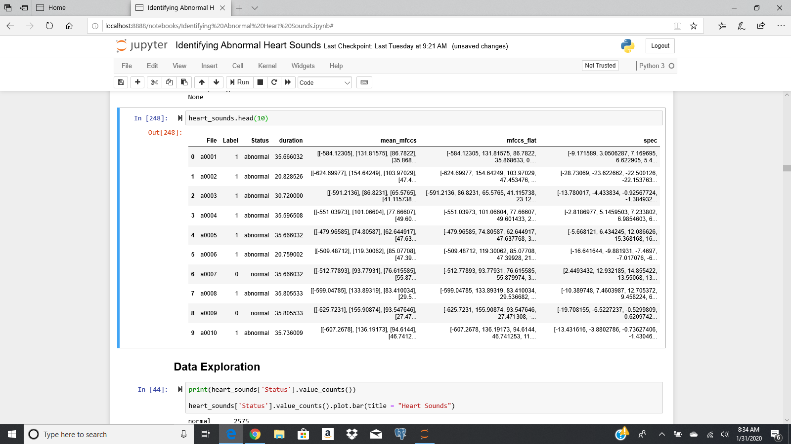
Data & Feature Extraction
Normal, Abnormal and Respiratory recordings (artifacts)
Features - Duration, spectrogram and mel-frequency cepstral coefficients (mfcc)
For spectrogram and mfcc data, took 10 second samples in order to standardize the data
Spectrogram data: A spectrogram is the visual representation of the spectrum of frequencies of a signal as it varies with time.
Have been shown to be effective in certain audio classification tasks – identifying bird calls
MFCC: Approximates the human auditory system's response more closely than the linearly-spaced frequency bands used in the normal cepstrum.
Have been shown to be effective in speech recognition use cases

Slide 4
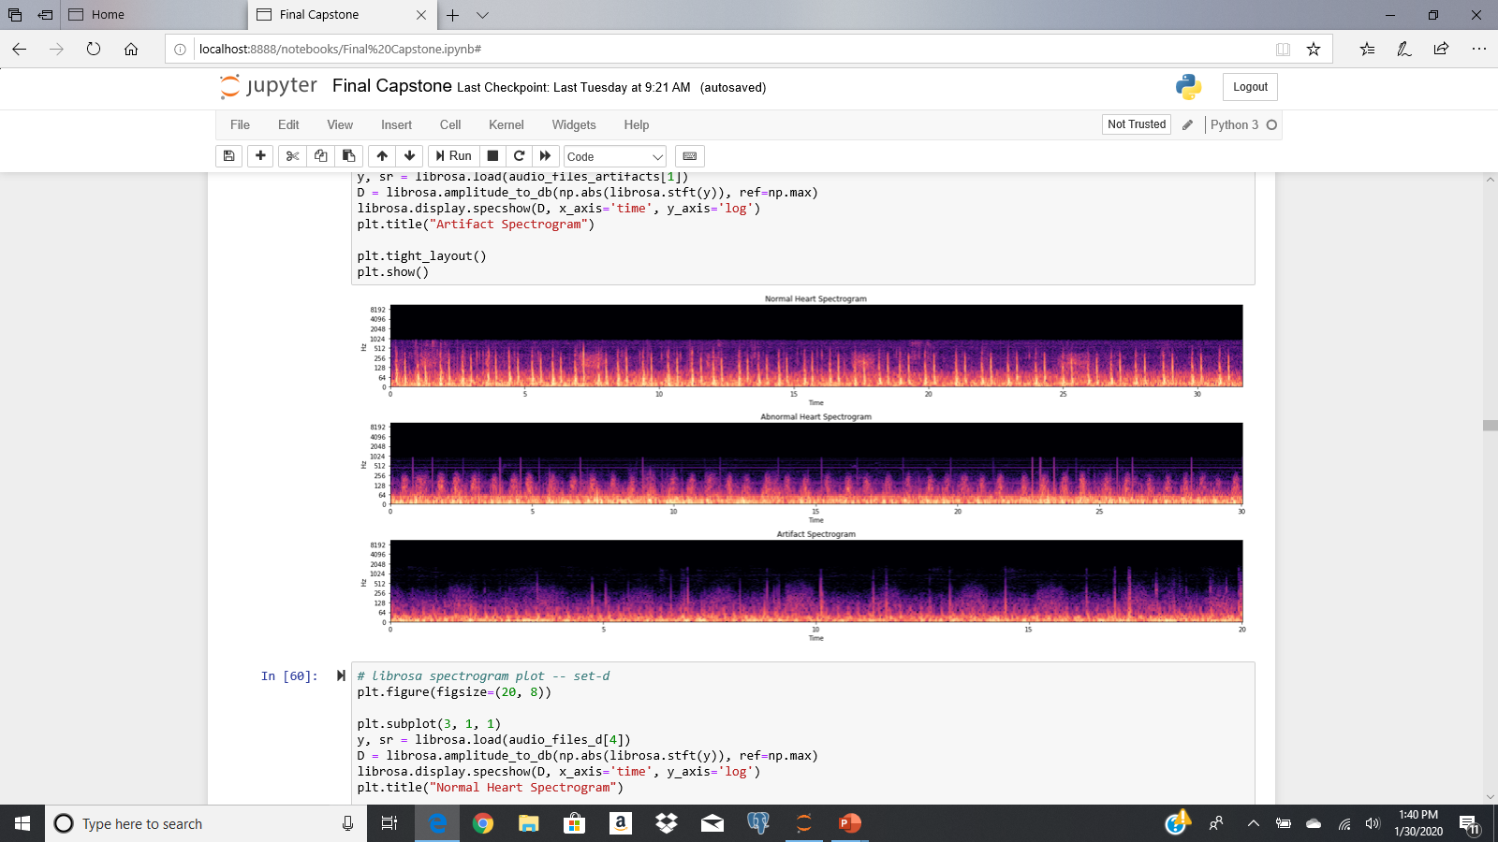
Data Visualization: Spectrogram

Slide 5
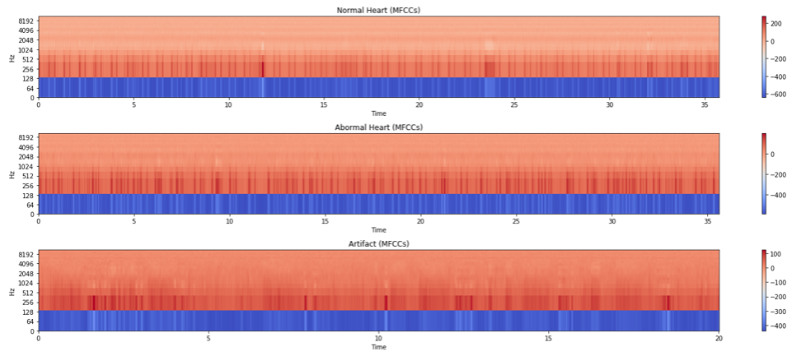
Data Visualization: MFCCs

Slide 6
Models: Supervised Learning
Tested on both spectrogram data and mfccs to determine which is better
4 Types: Logistic Regression, K-nearest Neighbor, Random Forest, Gradient Boosting
Maximize Precision – do not want to predict an abnormal heart as normal
Overall, the accuracy and precision was higher modelling off of the mfccs
Highest accuracy: K-nearest neighbors (91%)
Highest precision: K-nearest neighbors (90%)

Slide 7
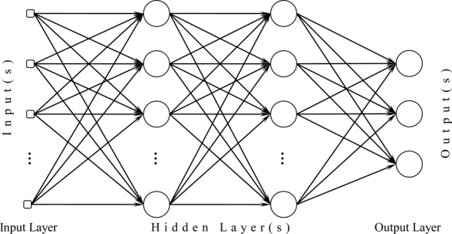
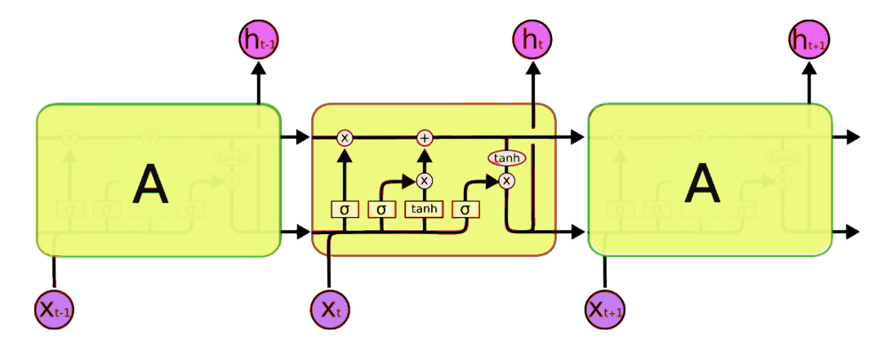
Deep Learning
Multilayer Perceptron
MLP and LSTM neural networks:
3 hidden layers
weighted abnormal (class imbalance)
Both spectrogram and mfcc data
Again, modelling off of mfcc data was more effective
For mfcc, MLP had 94% accuracy and 95% precision
LSTM had a 92% accuracy but only 94% precision
Long Short-Term Memory

Slide 8
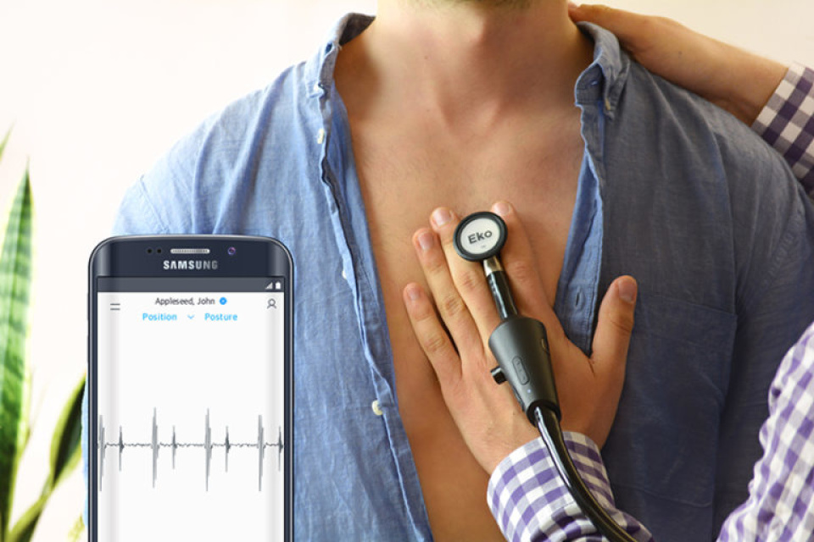
Applications
Integrate with Medical Equipment – Stethoscope
Supplement and reinforcement for current doctors or medically trained
Could be used by untrained to ascertain whether or not someone should be hospitalized
Eko Digital Stethoscope

Slide 9
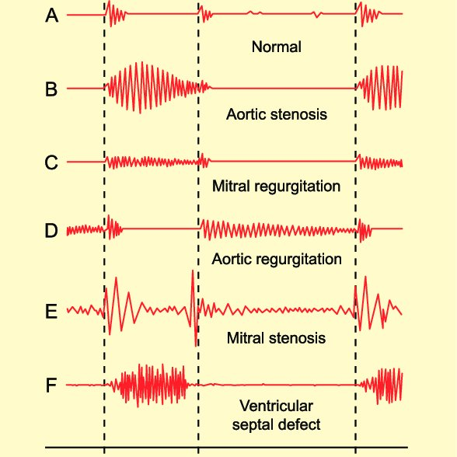
Further Steps
Further work to better separate normal versus abnormal
Start to identify specific abnormalities
Much more data!

